Slide 1
More Grid and Bootstrap
Chris Human ©2023

Slide 2
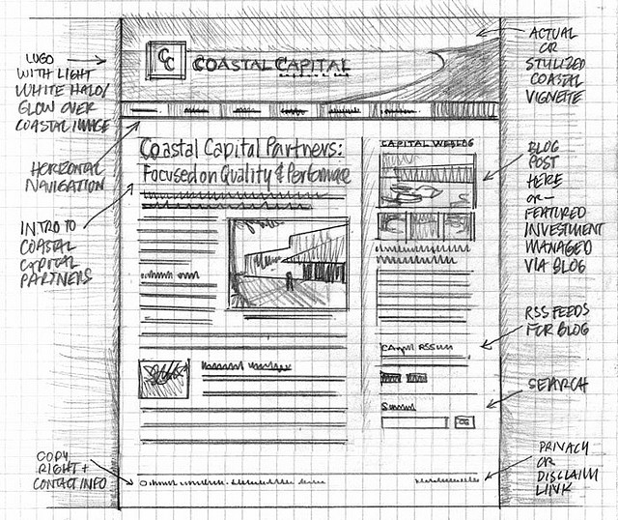
Importance of Sketches
Because every aspect of a site’s “look” is defined by HTML/CSS – it is crucial to have a detailed sketch going in.
Pay particular attention to the location of navigation bars, titles, headers, content, images, footers etc.
When imagining alignments, in particular, be mindful of the grid

Slide 3
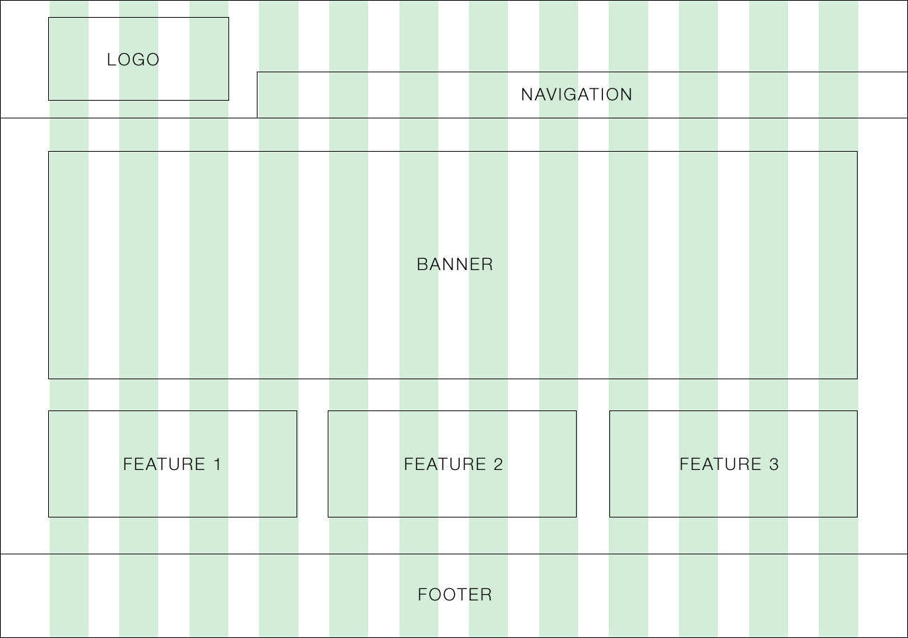
Designing with a Grid in Mind
Grids serve to align elements aesthetically

Slide 4

Facebook’s Grid
Facebook is a perfect example of a website where the “grid-layout” is obvious.
Grids make it easy to have content (text, images, and regions) align aesthetically.

Slide 5
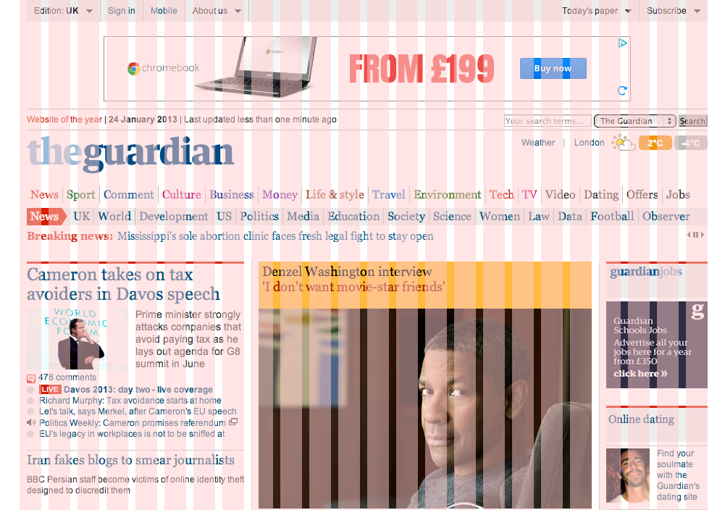
A More Complex Grid…

Slide 6
Rows and Columns

Slide 7
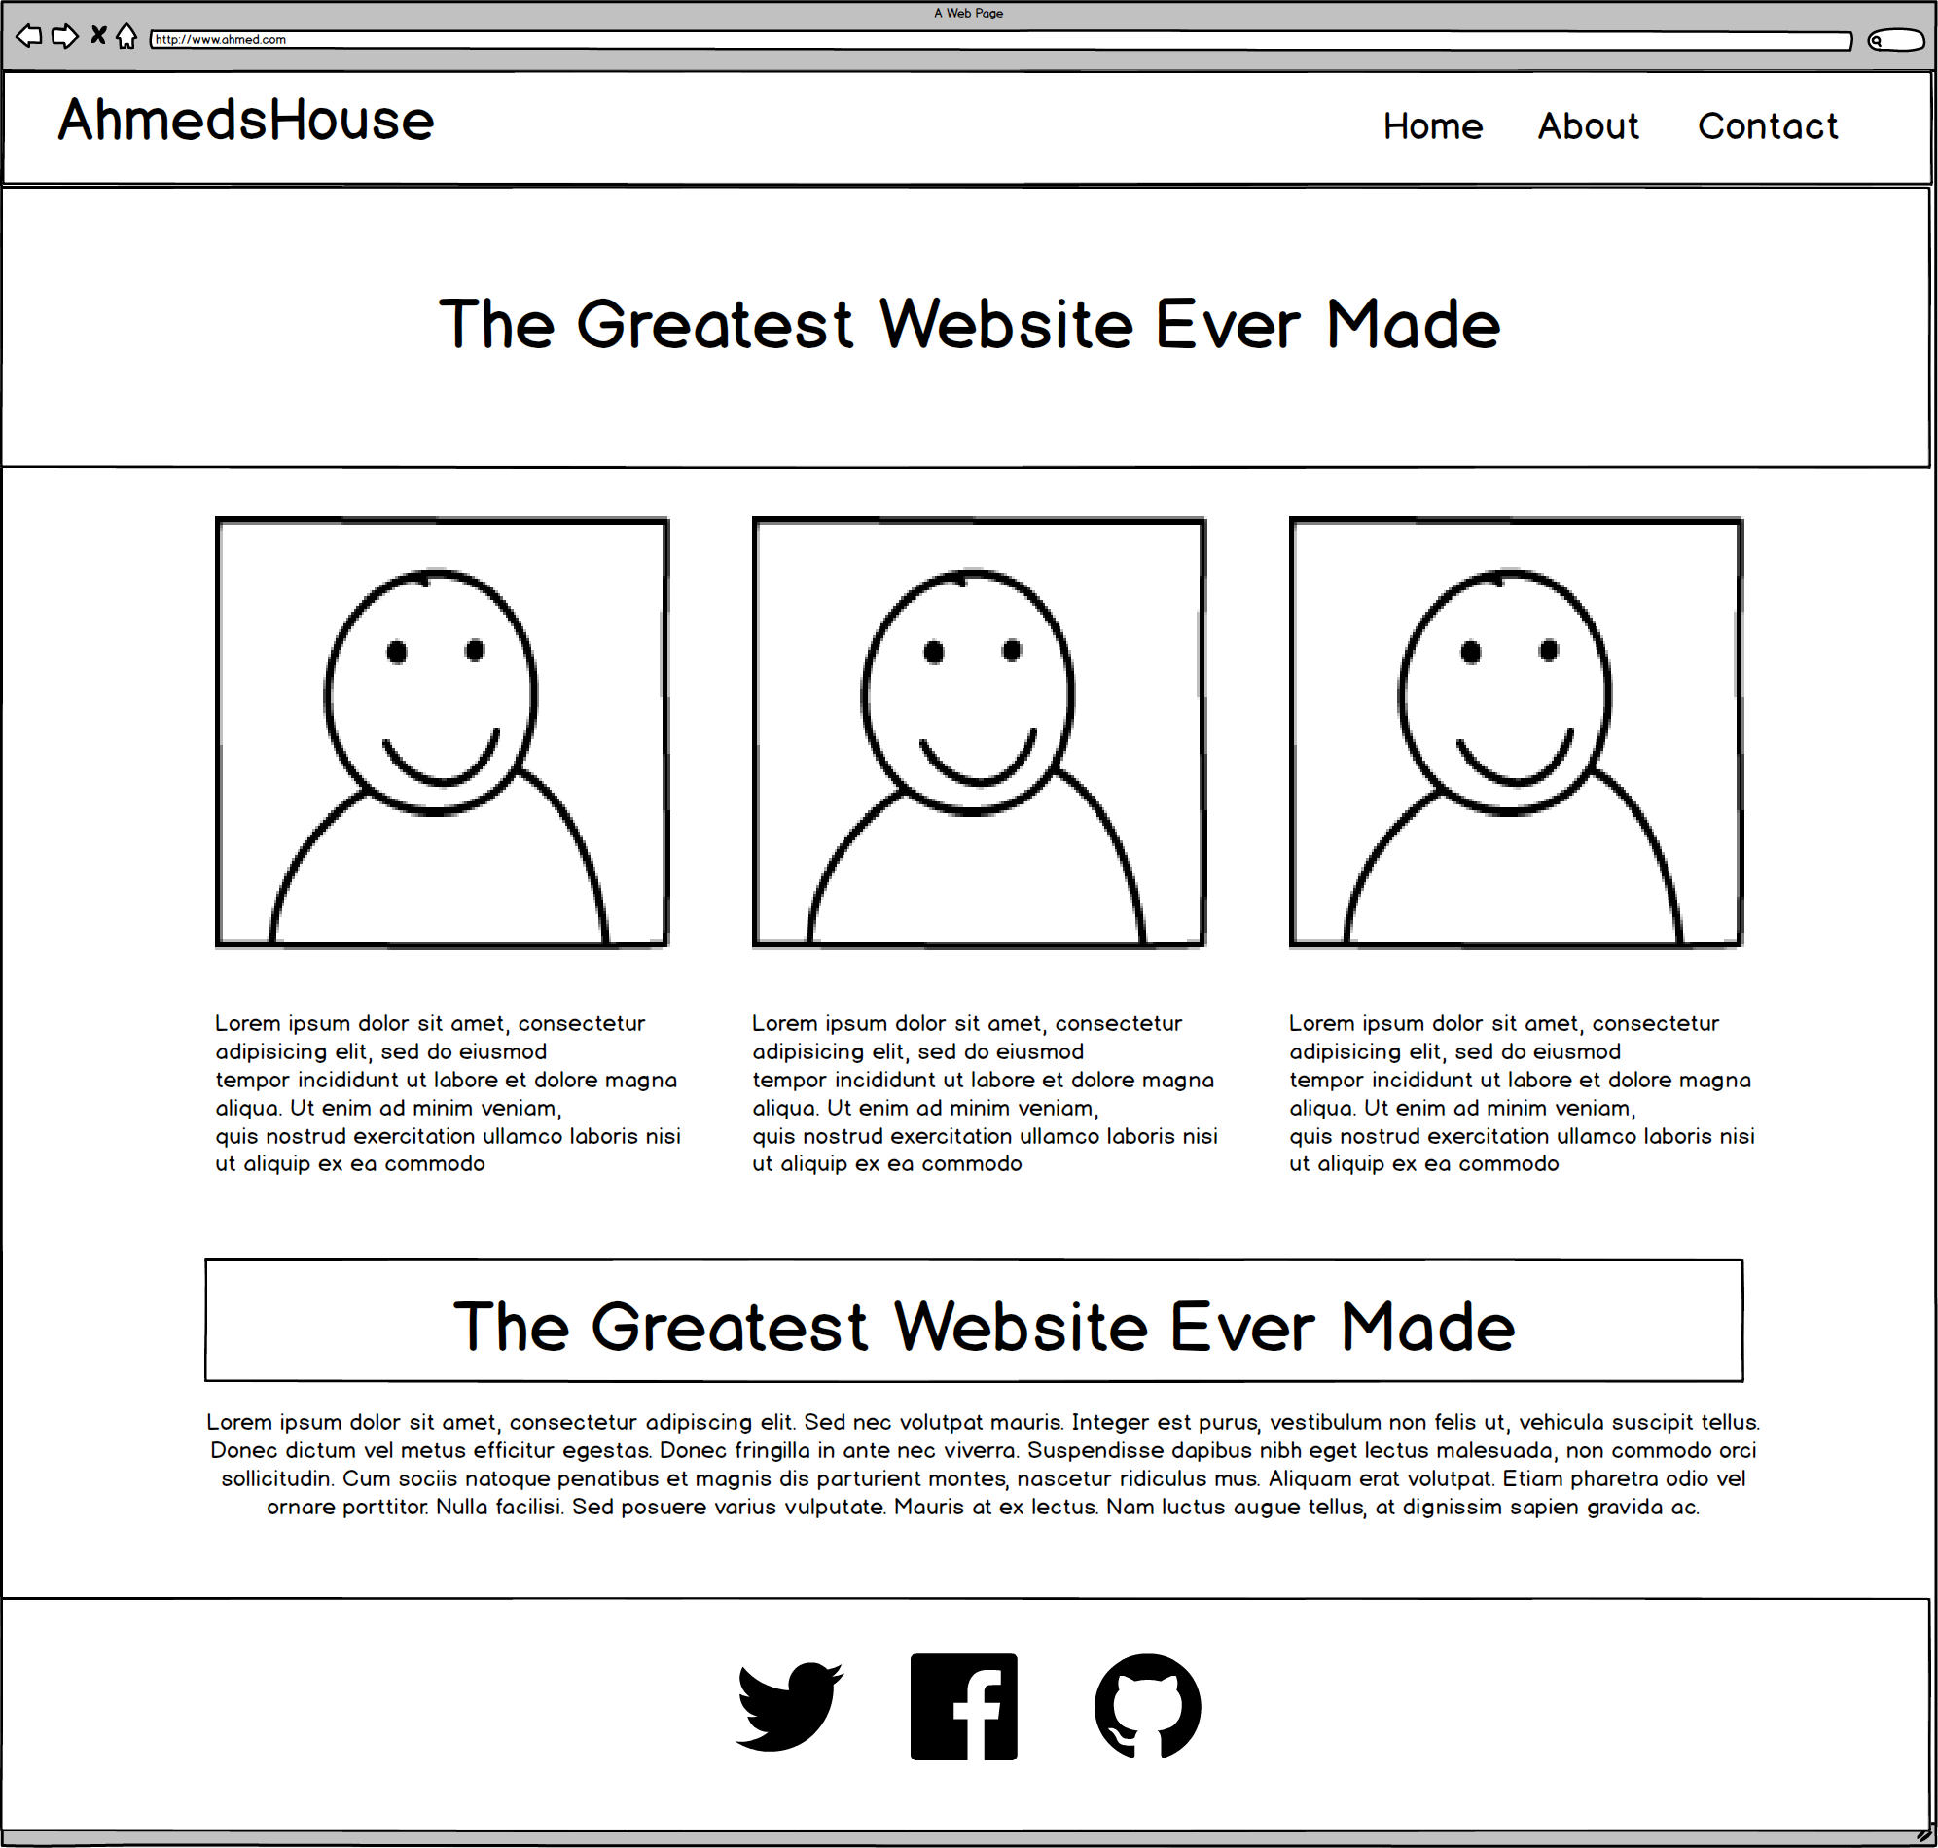
Web Design Fundamentally = Wireframes

Slide 8
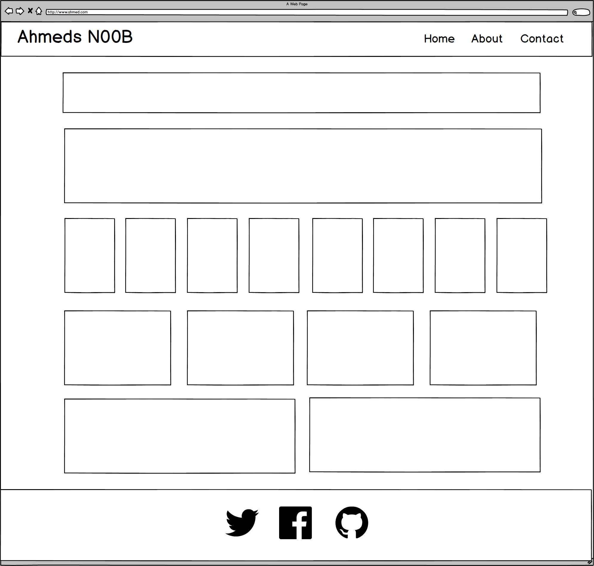
Web Design Fundamentally = Wireframes

Slide 9
Web Design Fundamentally = Wireframes

Slide 10
Design - Rows

Slide 11
Design - Columns

Slide 12
Now, let’s make it more challenging…

Slide 13
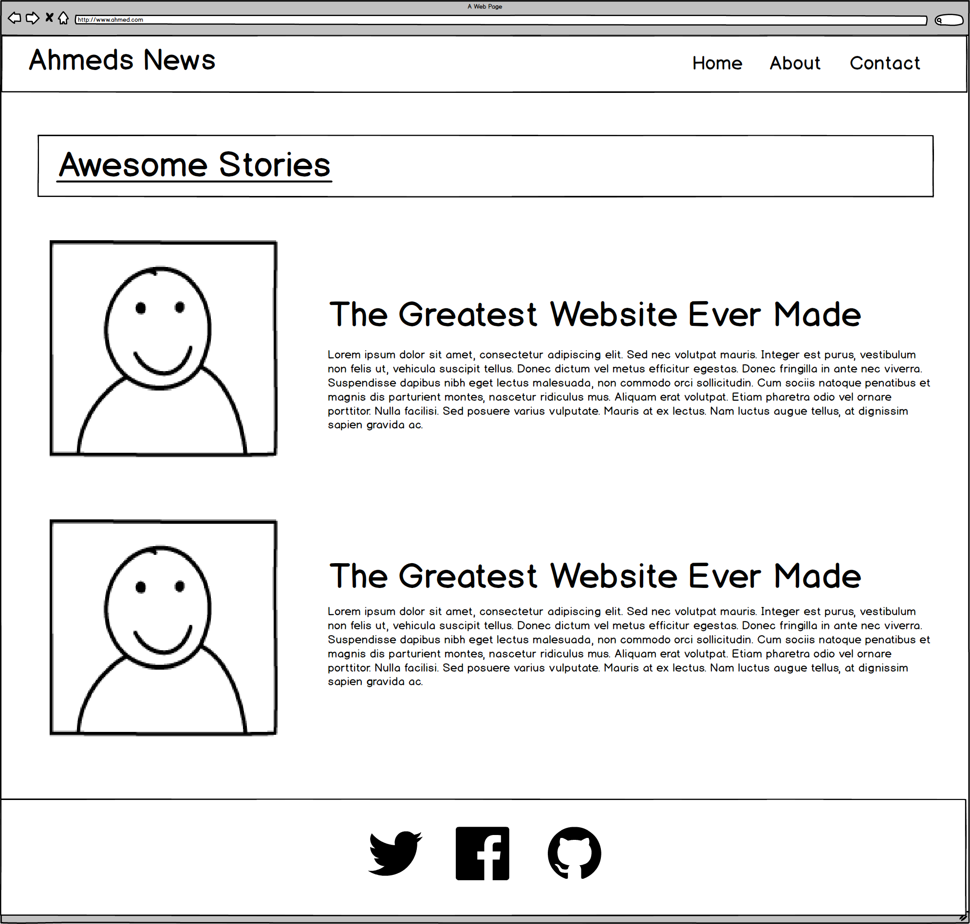
Web Design Fundamentally = Wireframes

Slide 14
Design - Rows

Slide 15
Design - Columns

Slide 16
Design - Examples

Slide 17
Design - Examples

Slide 18
Design - Examples

Slide 19

Design - Examples

Slide 20
Design - Examples

Slide 21
Design - Examples

Slide 22
Design - Examples

Slide 23
Bootstrap

Slide 24

Raw CSS

Slide 25
A Revelation
There is an alternative

Slide 26
Demo
Where’s the CSS?

Slide 27
Your Turn!
Activity: Where is the CSS?
Suggested Time: 5 min.
Assignment:
Review the HTML and determine where it is getting its styles from?
How does the browser know which HTML
Hint:
Think about the Google Fonts exercise

Slide 28
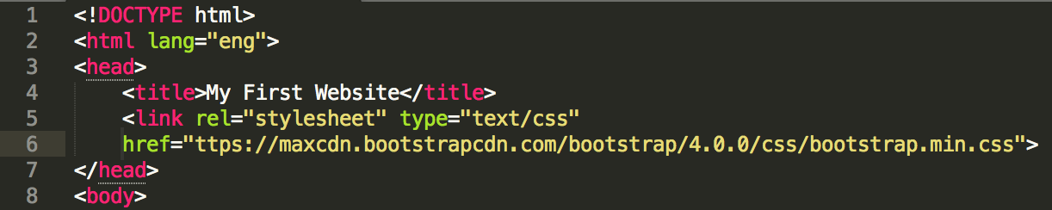
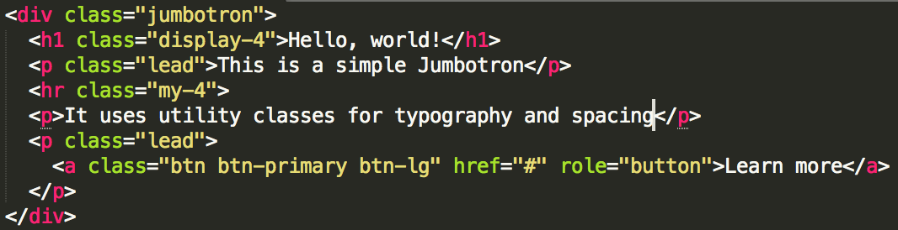
Powered by Bootstrap
External CSS Link
Pre-Defined CSS Class (ex: “Jumbotron”)

Slide 29
Your Turn!
Activity: Why Bootstrap?
Suggested Time: 5 min.
Assignment:
Think of a few reasons why you would want to use “pre-defined” CSS.
Think of a few scenarios where you would want to use “pre-defined” CSS over custom CSS.

Slide 30
What is Bootstrap?

Slide 31

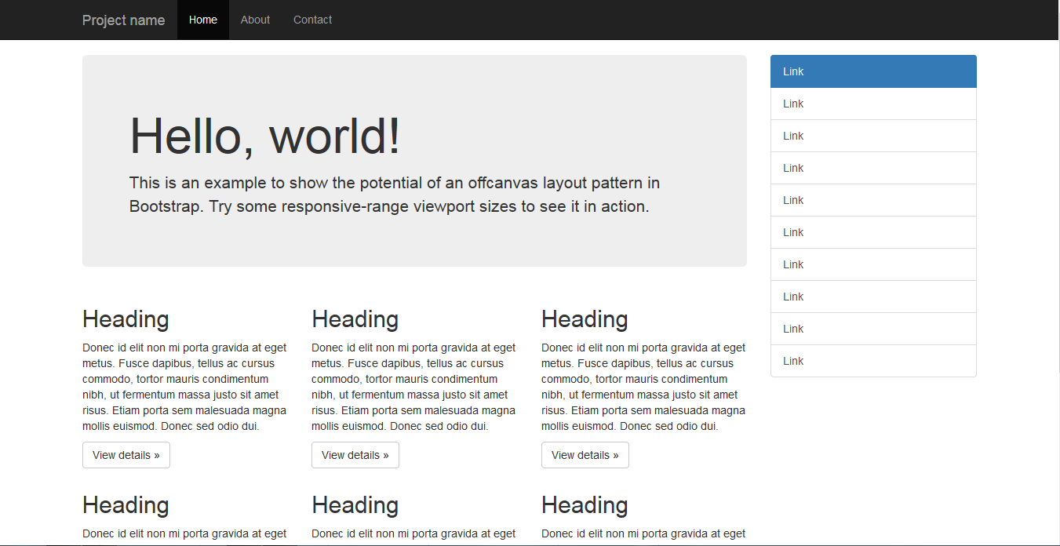
Bootstrap Definition
Twitter Bootstrap is a free collection of tools for creating websites and web applications.
It comes with a pre-built design template for typography, forms, buttons, navigation, UI elements and JavaScript.
Documentation here: http://getbootstrap.com/

Slide 32

Why Bootstrap?
Reason #1: UI Kit
Familiarize yourself with the UI features it offers via the documentation.
Once Bootstrap is active, you can simply copy snippets from the documentation to save yourself major time of creating elements yourself.

Slide 33

Why Bootstrap?
Reason #2: Mobile Responsiveness
One of the most compelling reasons to use Bootstrap is the default mobile-responsive quality it provides.
This means that your website will look “good” automatically when viewed on screens ranging from monitors to tablets to phones.

Slide 34


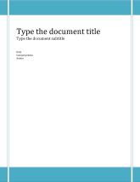
Why Bootstrap? (Analogy)
HTML Alone
Like writing papers in “Notepad.”
Can only write unformatted text.
HTML / CSS
Like writing papers in Microsoft Word.
Can format text, page settings, alignment, etc. based on “highlighting” and menu options.
HTML / CSS & Bootstrap
Like writing papers in Microsoft Word with a prebuilt template.
You can still customize, but now have a pre-built style and aesthetic look.

Slide 35
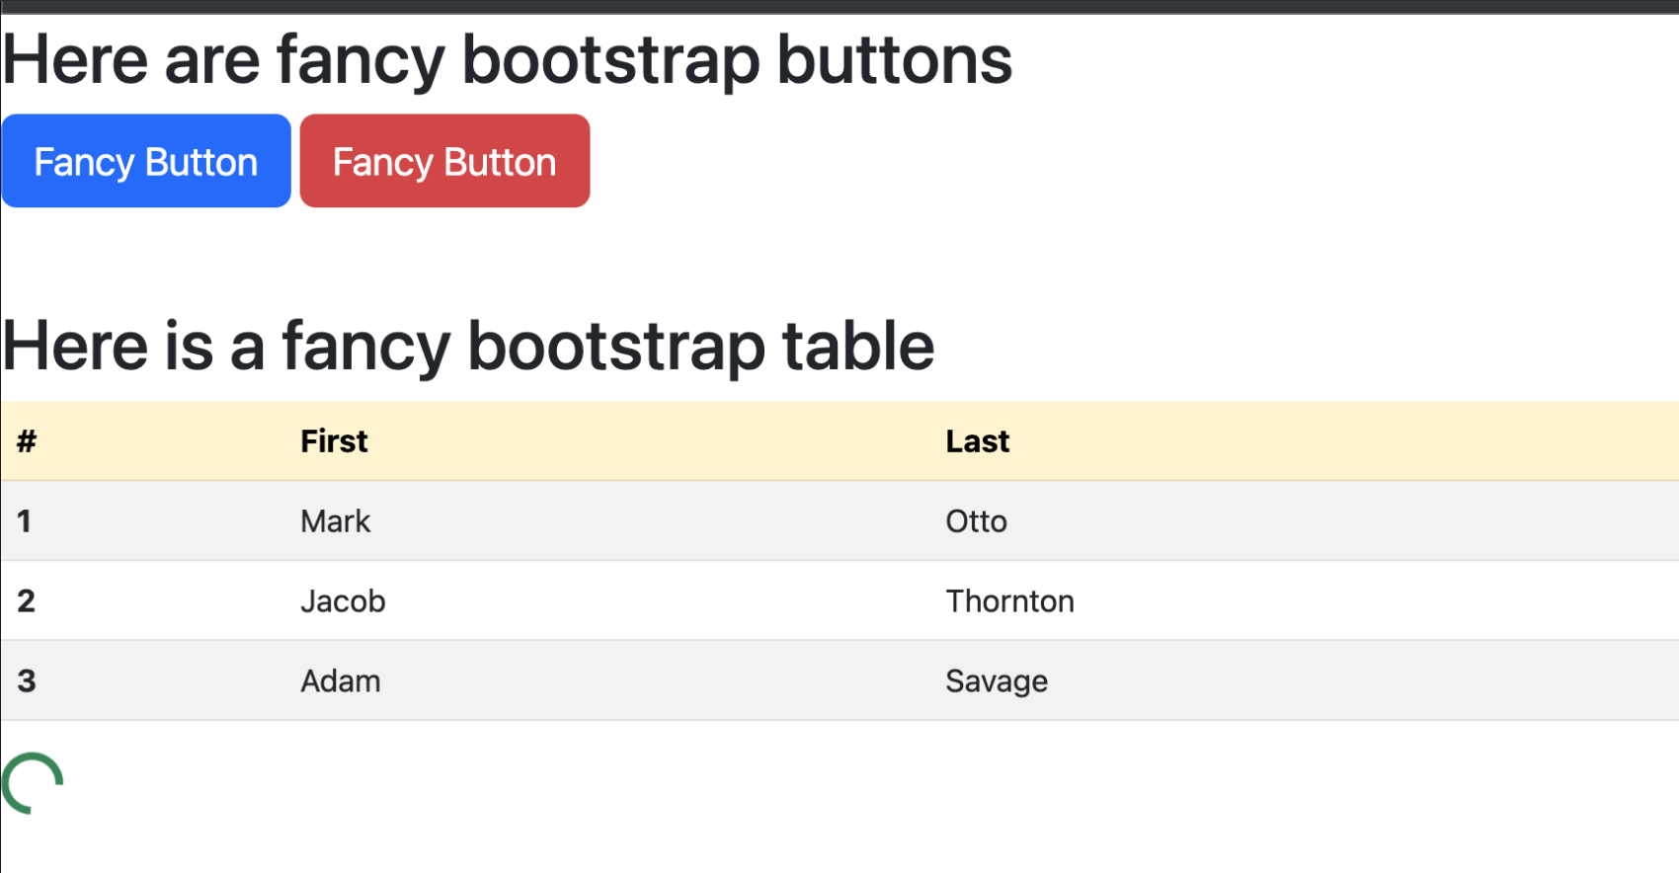
Your Turn!
Activity: Hands-On Bootstrap
Suggested Time: 15 min.
Assignment:
Navigate to the Twitter Bootstrap website.
Then copy the link to the Bootstrap CSS file into the HTML file
Look through the Bootstrap CSS or Components list and incorporate the necessary HTML, and Bootstrap classes and components to replicate the image below.

Slide 36
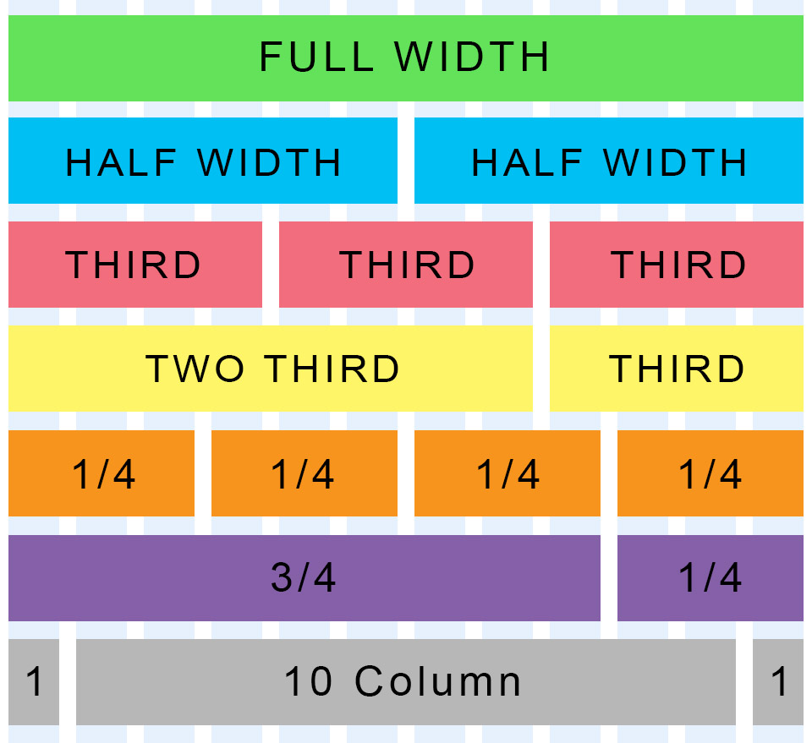
Bootstrap Grid
Bootstrap lets you organize content based on the “number of columns” a div spans – out of a total 12 columns.
Example:
<div class="col-md-12">
(Spans full width)
<div class="col-md-4">
(Spans 1/3 of full width)

Slide 37
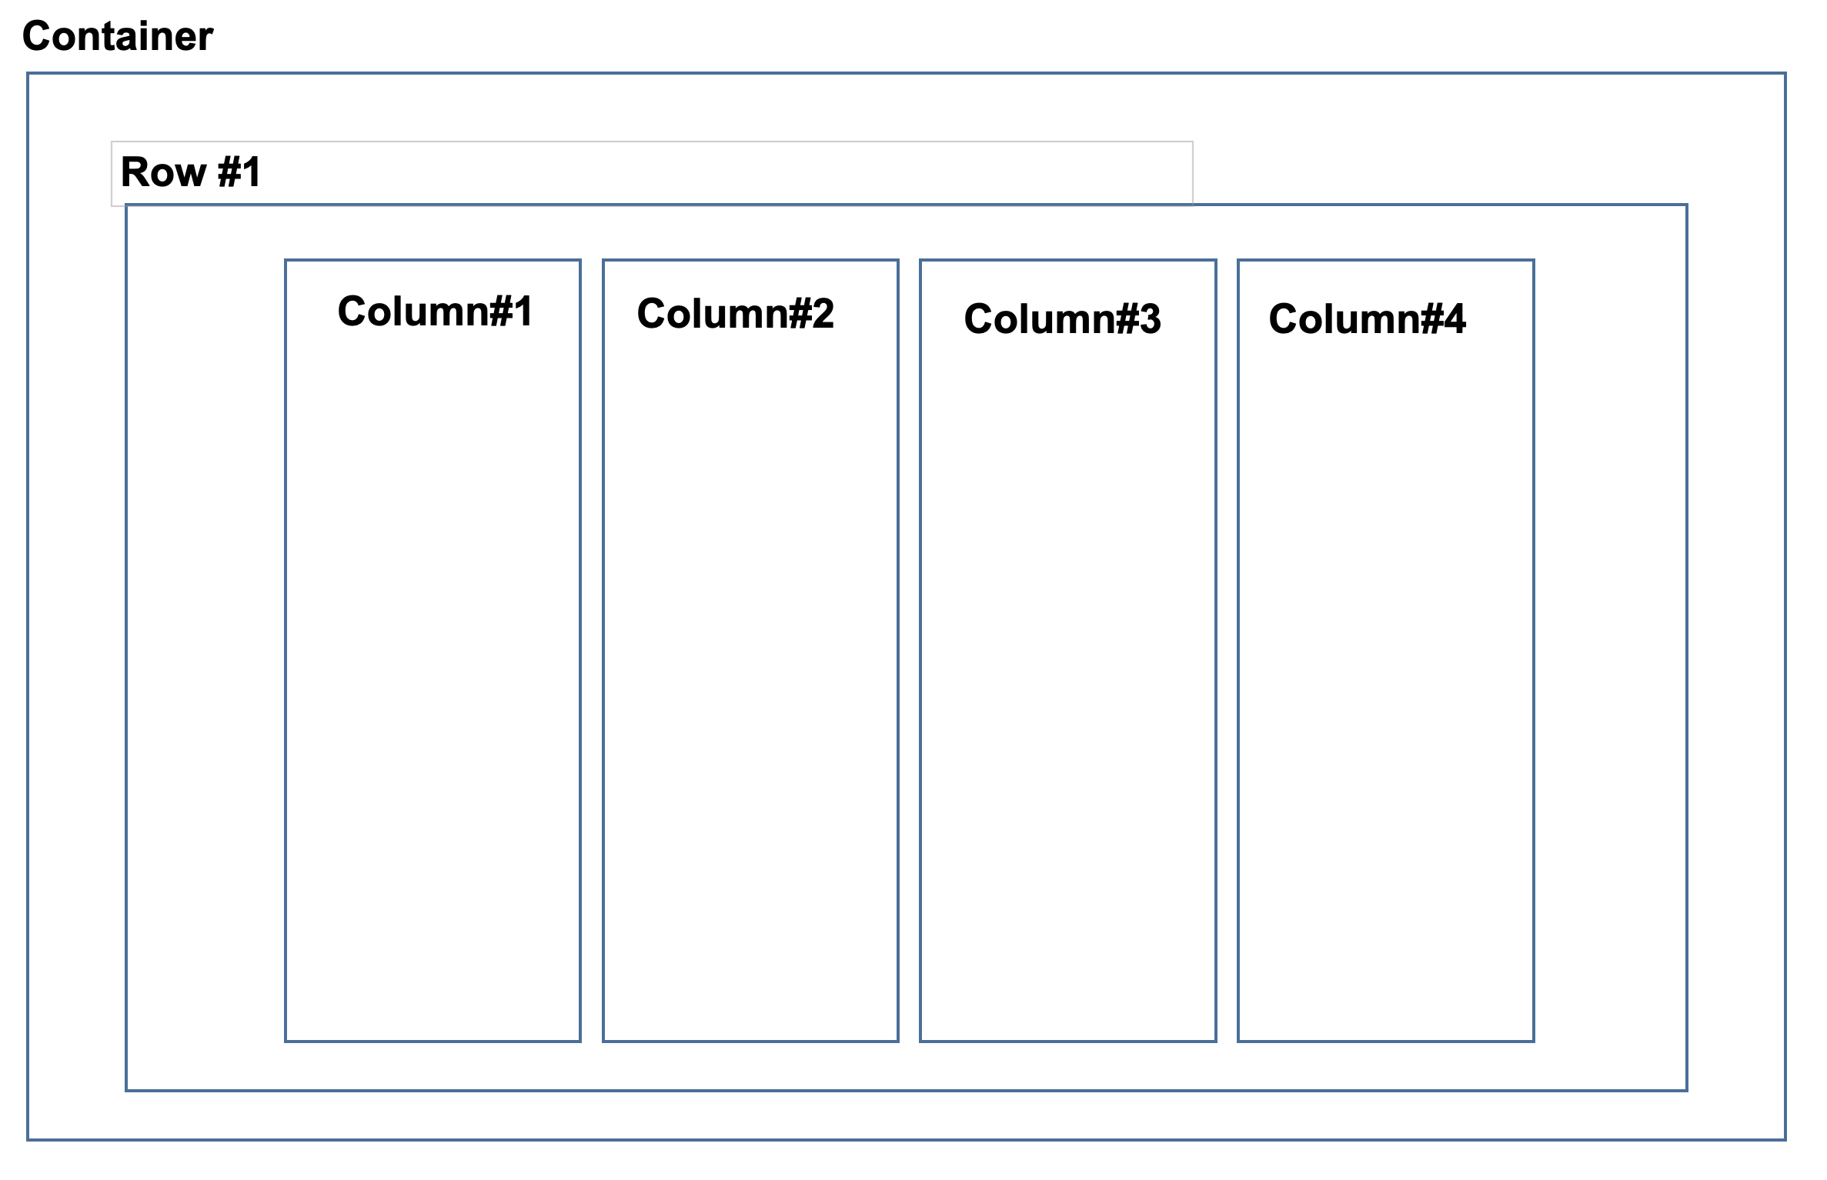
Defining Columns

Slide 38
Demo

Slide 39
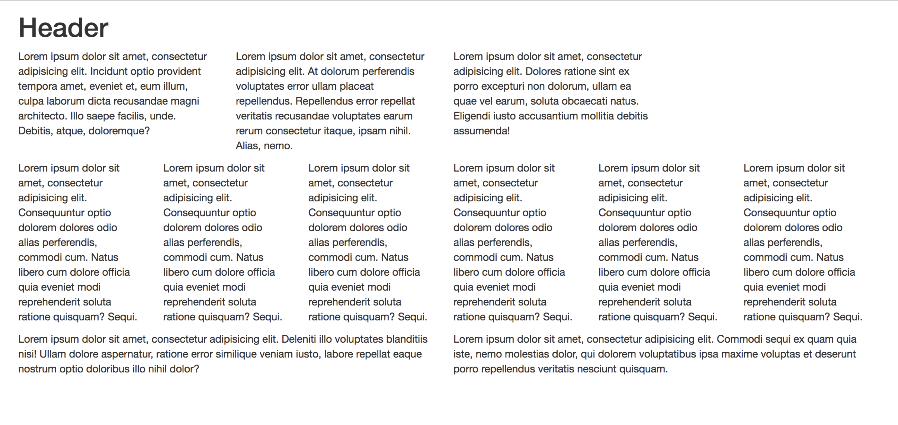
Your Turn!
Activity: Bootstrap Grid
Suggested Time: 15 min.
Assignment:
Navigate to the Twitter Bootstrap website.
Then copy the link to the Bootstrap CSS file into the HTML file
Look through the Bootstrap CSS or and implement the necessary HTML, and Bootstrap classes to replicate the image below.

Slide 40
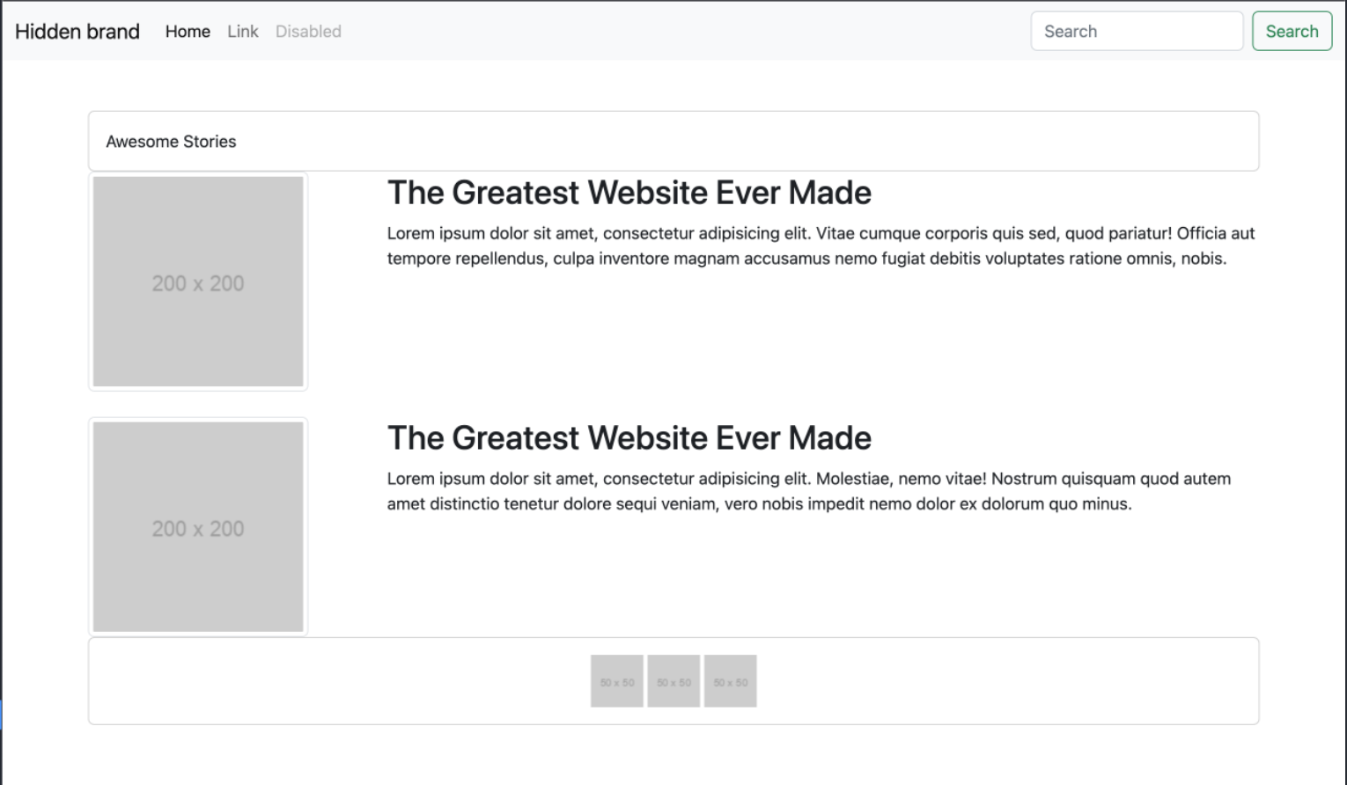
Your Turn!
Activity: Scratch Bootstrap Layout
Suggested Time: 35 min.
Assignment:
Create an HTML file and link to the Bootstrap CSS CDN.
Look through the Bootstrap CSS or and implement the necessary HTML, and Bootstrap classes/components to replicate the image below.

